Slide 1

Noida Institute of Engineering & Technology
Department of CSE (Data Science)
Session (2024-2025)
MINI PROJECT (ACSE0659)
Presentation on
“HerHustle - A Community-Powered Job Platform for Women"
Project Guide: Submitted To: Group Members:
Ms. SUMAN MISHRA ANSH MITTAL
ROLL NO:2201331540041
3RD YEAR, 6TH SEMESTER

Slide 2

Outline
Problem Statement
Literature Review
Introduction
Model
Frontend technologies Used
Backend Technologies Used
AI-tech
Monetization Policy
Research Gap
Future Scope
Bibliography
References

Slide 3
PROBLEM STATEMENT
Despite various job platforms, women, especially from rural, poor, and aged backgrounds, struggle to access safe and verified employment opportunities.
Workplace harassment, lack of trust, and limited networking opportunities worsen the situation.
Need for a dedicated, safe, and supportive employment platform for women at all stages of life.

Slide 4
Literature Review:
Platforms like LinkedIn, Indeed, etc., cater to a broad audience but lack focused community-driven support for women.
Research shows that peer-supported communities improve career outcomes and mental well-being for women.
There is a gap in verification, abuse reporting, and community-building specifically targeted toward women's employment platforms.

Slide 5
Introduction
HerHustle is a job and support platform exclusively for women.
It combines job opportunities, community support, trust verification, and abuse reporting to create a safe environment.
Targeted users include freelancers, job seekers, mentors, and employers from all economic backgrounds.

Slide 6
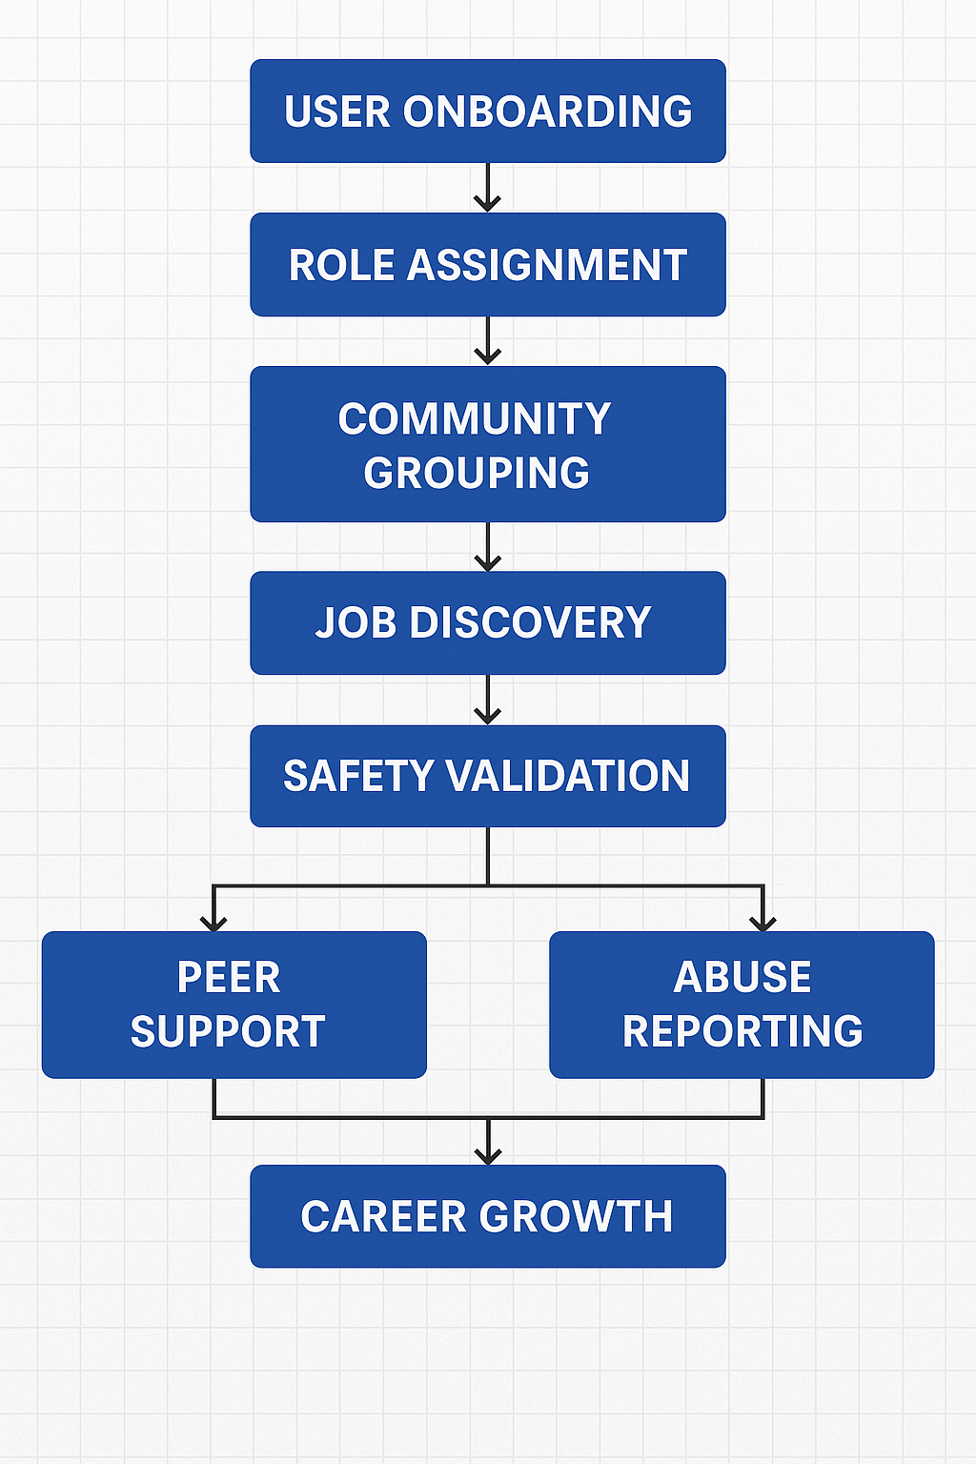

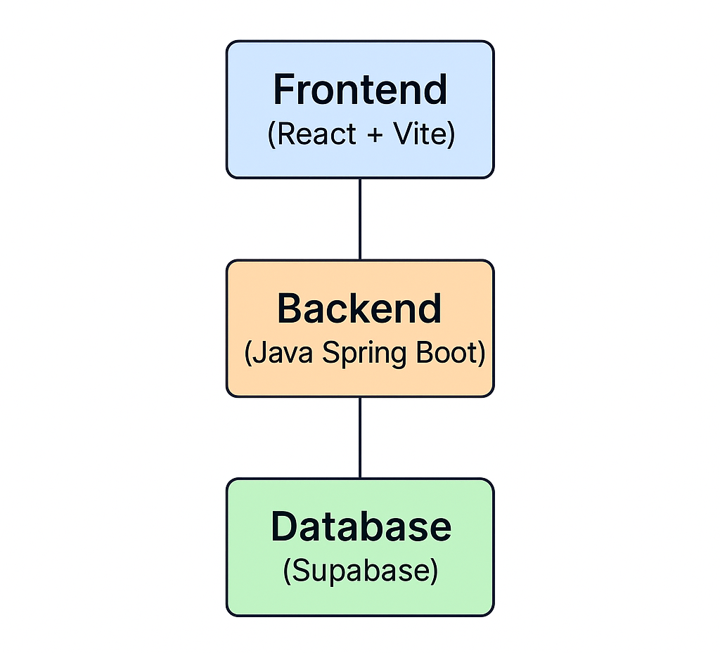
Model (Diagram/Design)

Slide 7
Frontend Technologies Used
React (Web development)
Vite (Frontend Bundler)
NPM (Package Manager)
Git (Version Control)

Slide 8
Backend Technologies Used
Java Spring Boot (Backend Server Framework)
Supabase (Database and Authentication)
Render (Cloud Hosting/Deployment)

Slide 9
AI-tech
Profile Verification using facial recognition or document AI.
Spam/Abuse Detection through Natural Language Processing (NLP) models in chats.
Recommendation Systems to suggest personalized job matches.
Trust Scoring System using AI-based reputation management

Slide 10
Monetization Policy
Freemium Model: Basic access is free; premium community memberships for exclusive job listings and mentorship.
Ad-Based Revenue: Ethical advertisements targeted toward women-centric products and services.
Partnerships: Collaborations with NGOs, women's organizations, and brands.

Slide 11
Research Gap
Existing platforms for professional networking and job placement have grown significantly, but solutions tailored specifically for women from diverse socioeconomic backgrounds remain limited.
Most current platforms focus primarily on urban, tech-savvy users, neglecting:
Women in rural areas
Daily wage workers
Older demographics seeking employment
Safety features (e.g., employer verification, abuse reporting, emotional support) are often secondary, not core components of these platforms.
There is limited research on community-driven job ecosystems that combine:
Professional opportunities
Peer mentorship
Emotional well-being support
Dynamic user profiling
Addressing these gaps is crucial to build inclusive platforms that holistically empower women, beyond just providing job listings.
HerHustle directly addresses these issues by:
Prioritizing safety and accessibility
Setting a new standard for women-centered career ecosystems

Slide 12
Future Scope
Expanding to global communities for cross-country job opportunities.
Integration of AI-powered career coaches and virtual job fairs.
Creating a mobile app version for broader accessibility.
Developing mental health support modules within the app.

Slide 13
Bibliography
Research Papers on Women Employment Trends
World Economic Forum Reports on Gender Gap
Studies on Online Harassment and Digital Communities
Technical Documentation: React, Java Spring Boot, Supabase

Slide 14
References
HerHustle Project Document — Provided by the user (HerHustle.pdf, 2025).
World Economic Forum Reports — "Global Gender Gap Report 2023".
LinkedIn Research — "The Power of Women’s Networks" (2022).
Supabase Documentation — Official website (https://supabase.com/docs).
ReactJS Official Documentation — React Developer Docs (https://react.dev/).
Java Spring Boot Documentation — Spring.io Guides (https://spring.io/projects/spring-boot).
Render Documentation — Render Cloud Platform Docs (https://render.com/docs).
Research Paper: "Online Harassment of Women: The Impact and Solutions" — Journal of Internet Studies, 2021.

Slide 15
Noida institute of Engineering & Technology
Thank you

